Slide 1
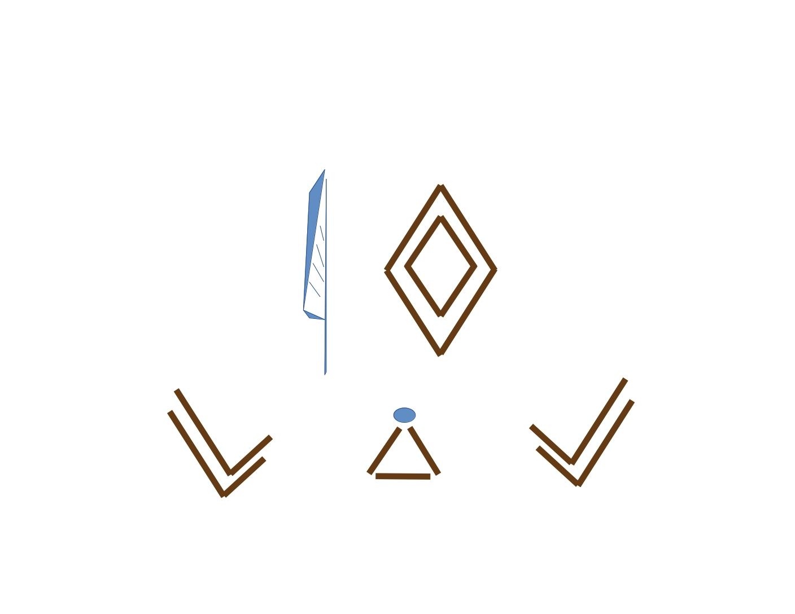
KryptoMagick

Slide 2
Services
Ancient Egyptian Language Services
Cryptologic Services
Research and Development
Language Services

Slide 3
Inventions
Egyptian Star Code Generator
Fetu Mathematical System
Book of Mormon Cryptanalysis Tool
Slip Public Key Algorithm
Q’loQ Public Key Algorithm

Slide 4
Inventions
Card Ciphers
Tarot Methods
WIQA Series Hand Ciphers
Purple Hand Cipher
DarkCastle File Encryption Algorithm
Kryptographic Music

Slide 5
Areas of Focus and Expertise
Cryptographic Research (Symmetric/Assymetric)
Wiccan and Pagan Practices (As it relates to mathematics, astronomy and nature)
The Occult (Ancient demonology rites, banishing rituals)

Slide 6
Named Areas of Interest
The Joseph Smith Method (including papyri and divination tools)
Jewish Divination Methods
Connections between ancient and present religions and the languages of the Earth

Slide 7
Why you should fund?
KryptoMagick is dedicated to uncovering new mathematical and theoretical ways that we can tap into the future and the past simulateously
KryptoMagick will always release true and unbiased information based on personal evidence and testimony
KryptoMagick is the one Wiccan Cryptographic Research and Development Company that hopes to share the love of Earth religions and Magick with all

Slide 16
Qualifications
Technological and cryptographic skills
Modular Arithmetic

Slide 17
Mission
To research and discover hidden messages in the fabric of existence using ancient methods
To decipher Ancient codes

Slide 18
Pitch
KryptoMagick offers the chance to discover the connections between our past, present and nature
Natural Magick is the key

Slide 19
Discoveries
Supposed text of A the Moon Goddess
Supposed text of Q the Dream Goddess
Supposed additions to the Egyptian Book of the Dead

Slide 20
Egyptian Star Code Generator
An algorithm to map the stars in the sky

Slide 21
Book of Mormon Cryptanalysis Tool
A program to unmask the Egyptian history contained within the cipher text of the Mormon text
2 Nephi Chapter 25:1

Slide 22
Slip Public Key Algorithm
Introduction of the concept of the Secret Modulus

Slide 23
Q’loQ Public Key Algorithm
Introduction of the Modulus and the Mask

Slide 24
Cube Card Cipher
Card Cipher resembling ciphering machines of the past

Slide 25
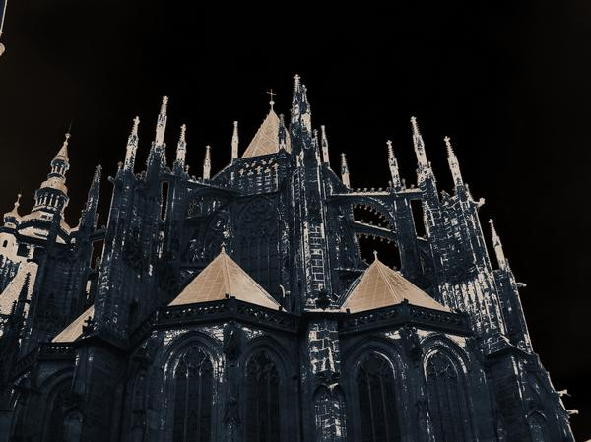
DarkCastle

Slide 26
DarkCastle
File Encryption Program

Slide 27
Application Purpose
To help me learn how to construct cryptographic primitives
Provide secure file storage against real world adversaries
To allow secure communication between two parties

Slide 28
Design Goals
To resist real world adversaries
To allow fast file encryption arbitrary file sizes
To detect tampering of messages
To offer only Quantum safe key sizes for symmetric key algorithms
To utilize no external libraries (sigh!)

Slide 29
Application Features
Secure storage of files or transfer of messages
Fast file encryption
File tampering detection
Sender/Receiver tampering detection

Slide 30
Language/Libraries
Written in C
OpenSSL BigNum Library and PRNG used for public key cryptography

Slide 31
Project History
First commit in 2017
Reached version 1.0 milestone in 2020

Slide 32
Project Phases
Symmetric encryption of files + passphrase
Symmetric encryption of files + message authentication + passphrase
Symmetric encryption of files + message authentication + sender authentication + passphrase protected public keys

Slide 33
Symmetric Primitives Used
Dark (Stream) 256-bit
Uvajda (Stream) 256-bit
Spock (Block) 256-bit
Amagus (Stream) 256/512/1024-bit
Q’apla (Stream) 256-bit
ZanderFish2 (Block) 256-bit
ZanderFish3 (Block) 256/512/1024-bit

Slide 34
Hash/HMAC/KDF Primitives Used
Ganja 256-bit – Hash/HMAC
Manja - KDF
Spock (Block 128-bit block size) 256-bit
Amagus (Stream) 256/512/1024-bit
Q’apla (Stream) 256-bit
ZanderFish2 (Block 128-bit block size) 256-bit
ZanderFish3 (Block 256-bit block size) 256/512/1024-bit

Slide 35
Public Key Algorithm Used
Q’loQ RSA 3072-bit

Slide 36
How Does It Work?
Alice and Bob run `castle-keygen` to set a passphrase to with which to lock their private key and generate their public keys
Alice and Bob exchange .pk files
Alice and Bob agree to use the Uvajda cipher
Alice types a letter to Bob and encrypts and signs it using DarkCastle `castle uvajda -e letter letter.encrypted Alice.pk Alice.sk`
Bob receives the encrypted message and decrypts it using DarkCastle `castle uvajda -d letter.encrypted message.from.alice Bob.sk Bob.pk`

Slide 37
What about Evil Eve?
If Eve intercepts the message between Alice and Bob and attempts to alter the message body. The alteration will be detected by Manja before decryption is attempted.
If Eve attempts to forge a digital signature from Bob, DarkCastle will defend you and inform you that the message is not from who you think it is.

Slide 38
Statistical Testing
All DarkCastle algorithms pass industry standard statistical tests including tests from NIST

Slide 39
Cryptanalysis
No publicly known attacks

Slide 40
Research Resources
Coursera
IACR
Christof Parr Course Videos on Youtube
RSA Conference Videos
Lectures by Dan Boneh
MIT OpenCourseWare, lectures by Rivest, Goldwasser and Vaikunatunathan

Slide 41
Research Resources (Books)
Applied Cryptography
Handbook of Applied Cryptography
The Design of Rijndael

Slide 43
Additional Services
Cipher design (1-3 months) {depending on the desired security level}

